Slide 1


PROPIFY
RENTAL WEB-APP
Mentor:
Aditya Makwe
Department Department of Computer Engineering

Slide 2


Agenda
Team Members
Project Brief
Problem Domain
Solution Domain
Technologies
Tools
Demonstration

Slide 3

Team Members
Abhin Koul
Computer Engineering
20C7102
Mohmmad Musaib
Computer Engineering
20C7139
Vibhu Mishra
Computer Engineering
20C7176

Slide 4

Project Brief
Project Name: Propify-Web App
Project Objective:
Digital Transformation in Real Estate
Centralized system for maintaining Real-estate system
Unified platform for property buyers, sellers, and renters,
User authentication and authorization, ensuring a trustworthy login experience
Bridge the gap between traditional practices and modern expectations.

Slide 5

Problem Domain
Real Estate Industry Challenges: Inefficiencies and fragmentation present in Real Estate.
User Interface Frustrations
Delayed Updates
Complex User Authentication
Lack of Offer Visibility
Inefficient Property Search and Data accuracy
User Discomfort and Lack of Trust.
Lack of Transparency and Inadequate Support.

Slide 6

Solution Domain
User friendly interface for customer and Owner
Real-Time Data Updates
User Authentication and Authorization
Offers and Discounts Section
Responsive Design and UI.
Streamlining Property Transactions
Mobile Accessibility and Cloud Benefits
Global Authentication and Data Privacy
User Feedback Integration

Slide 7
Project Description
Admin
Can create account and update his profile.
Adding new property and can also update the existing one
Admin gets notified through E-mail for queries.
Can manage offers and discounts
Can view all of the submitted feedbacks
Can Upload Photos and Videos of the property
Log in and manage property listings from various devices, including desktops, laptops, tablets, and smartphones.

Slide 8
Project Description
Customer User
Enjoy a user-friendly and intuitive interface
Conduct property searches with filters for location, type & price range
Register and log in securely using Google authorization.
View detailed property information, including descriptions, images, and prices.
Explore exclusive property-related offers and discounts.
Can submit feedbacks and ratings.
Log in and manage property listings from various devices, including desktops, laptops, tablets, and smartphones.

Slide 9

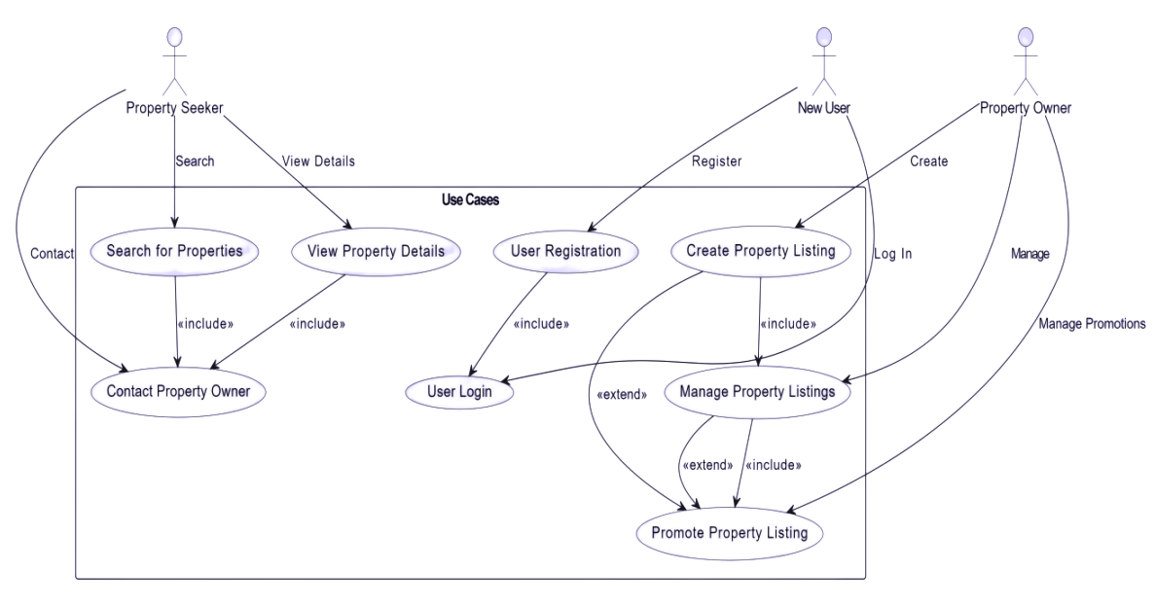
Use Case Diagram

Slide 10
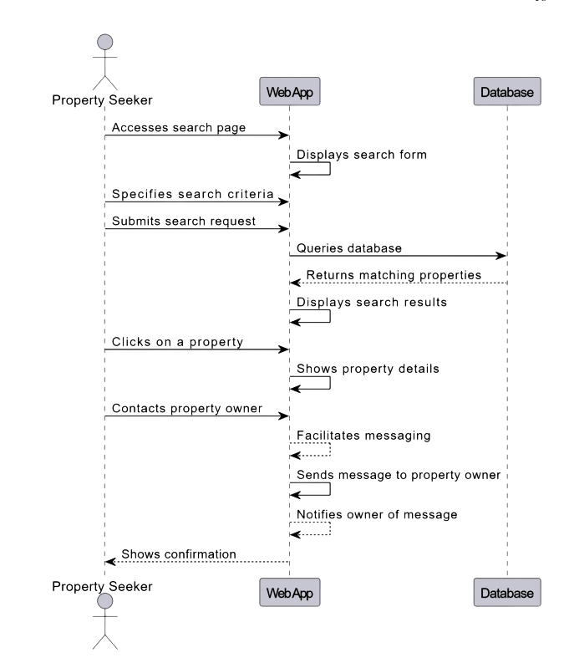

Sequence Diagram

Slide 11


Technologies
Front-end
JavaScript
HTML
CSS
React Js

Slide 12

Technologies
Back-end
Google Firebase
Java

Slide 13



Tools
Virtual Studio
Git Hub
Google Firestore

Slide 14
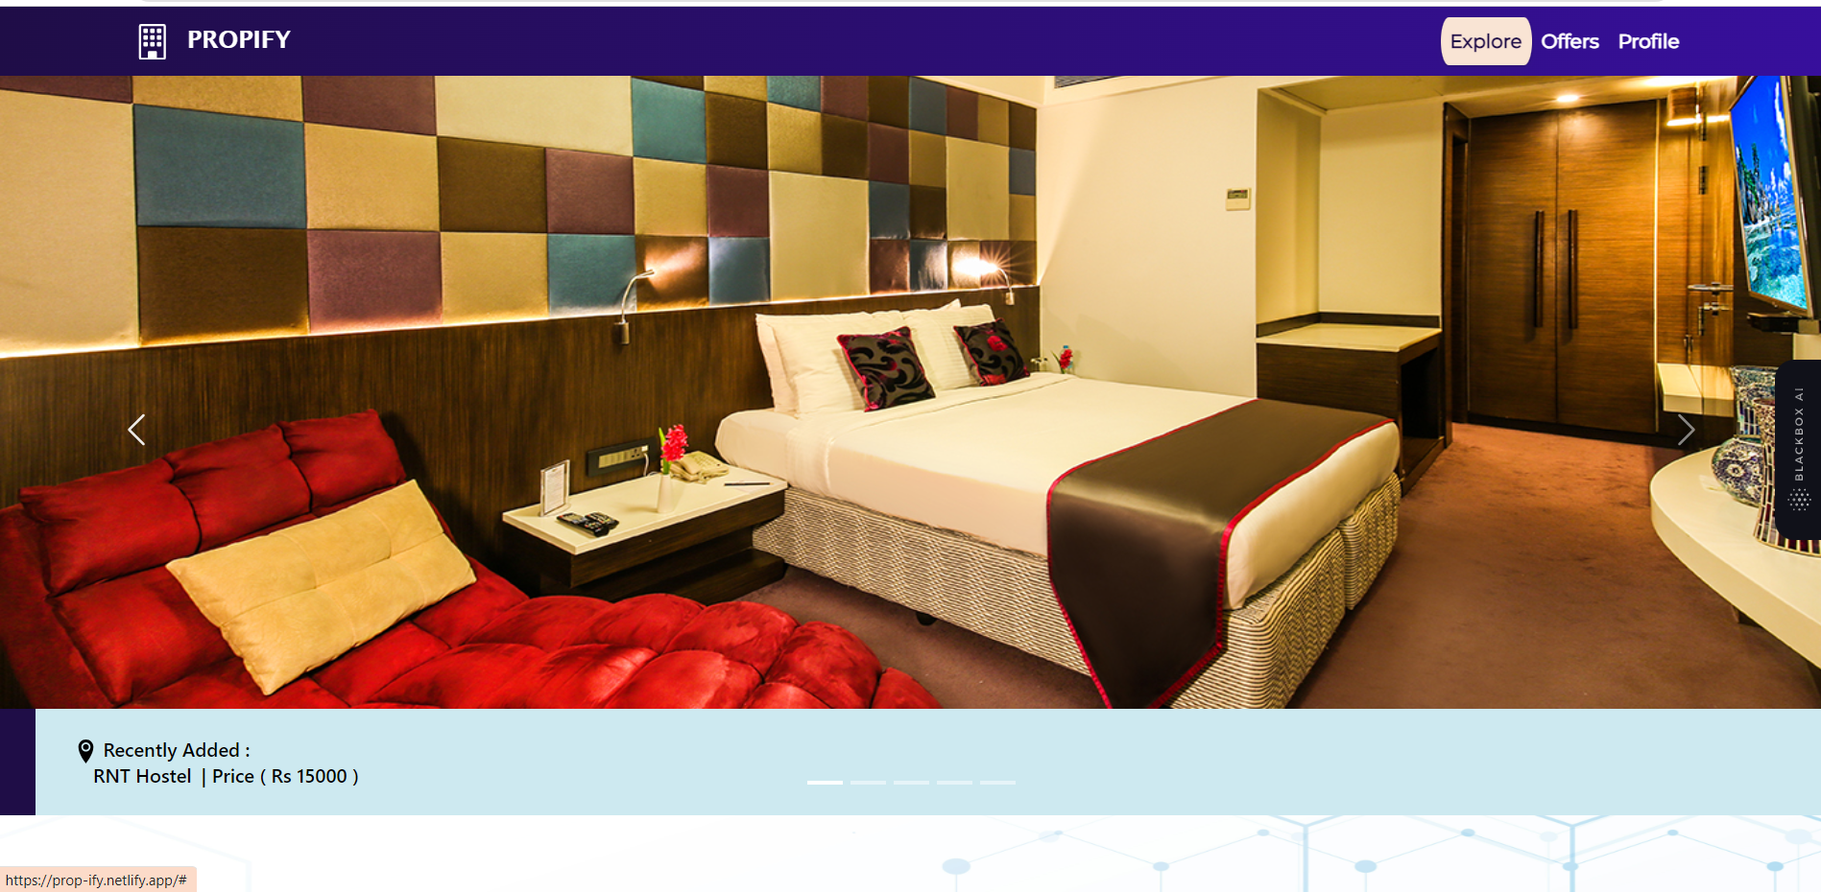
Project Demonstration
Front Page

Slide 15
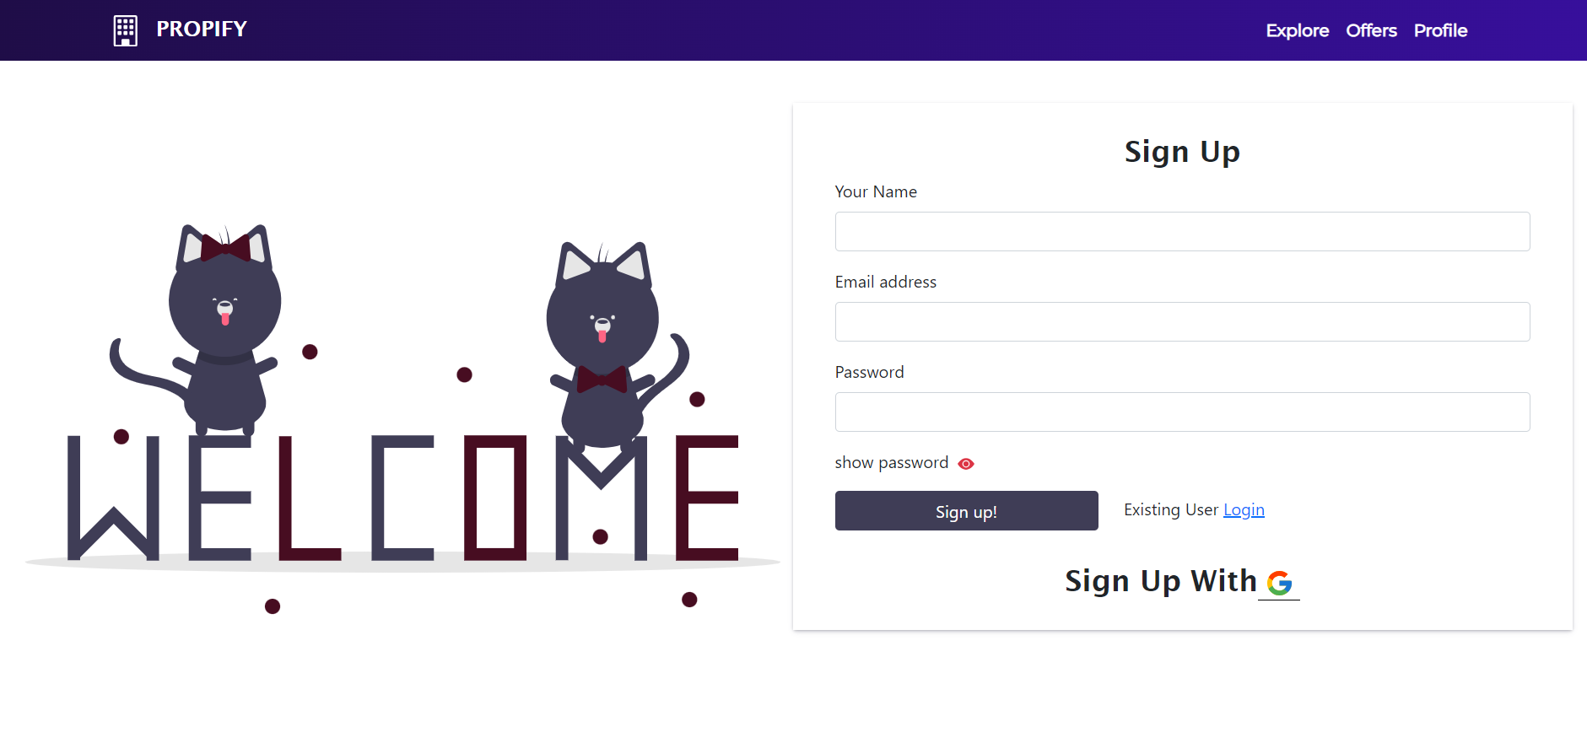
Project Demonstration
SignUp Page

Slide 16
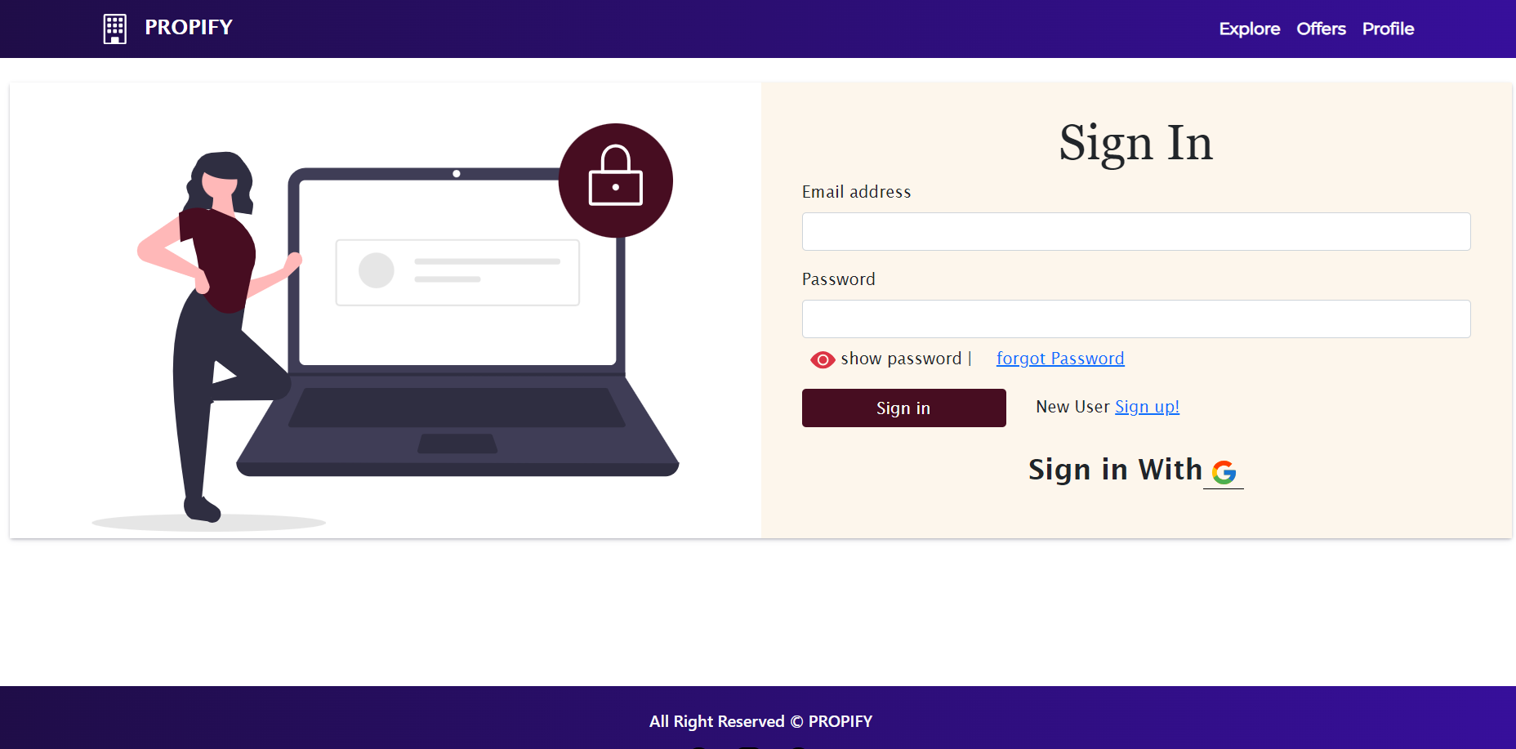
Project Demonstration
Sign In Page

Slide 17
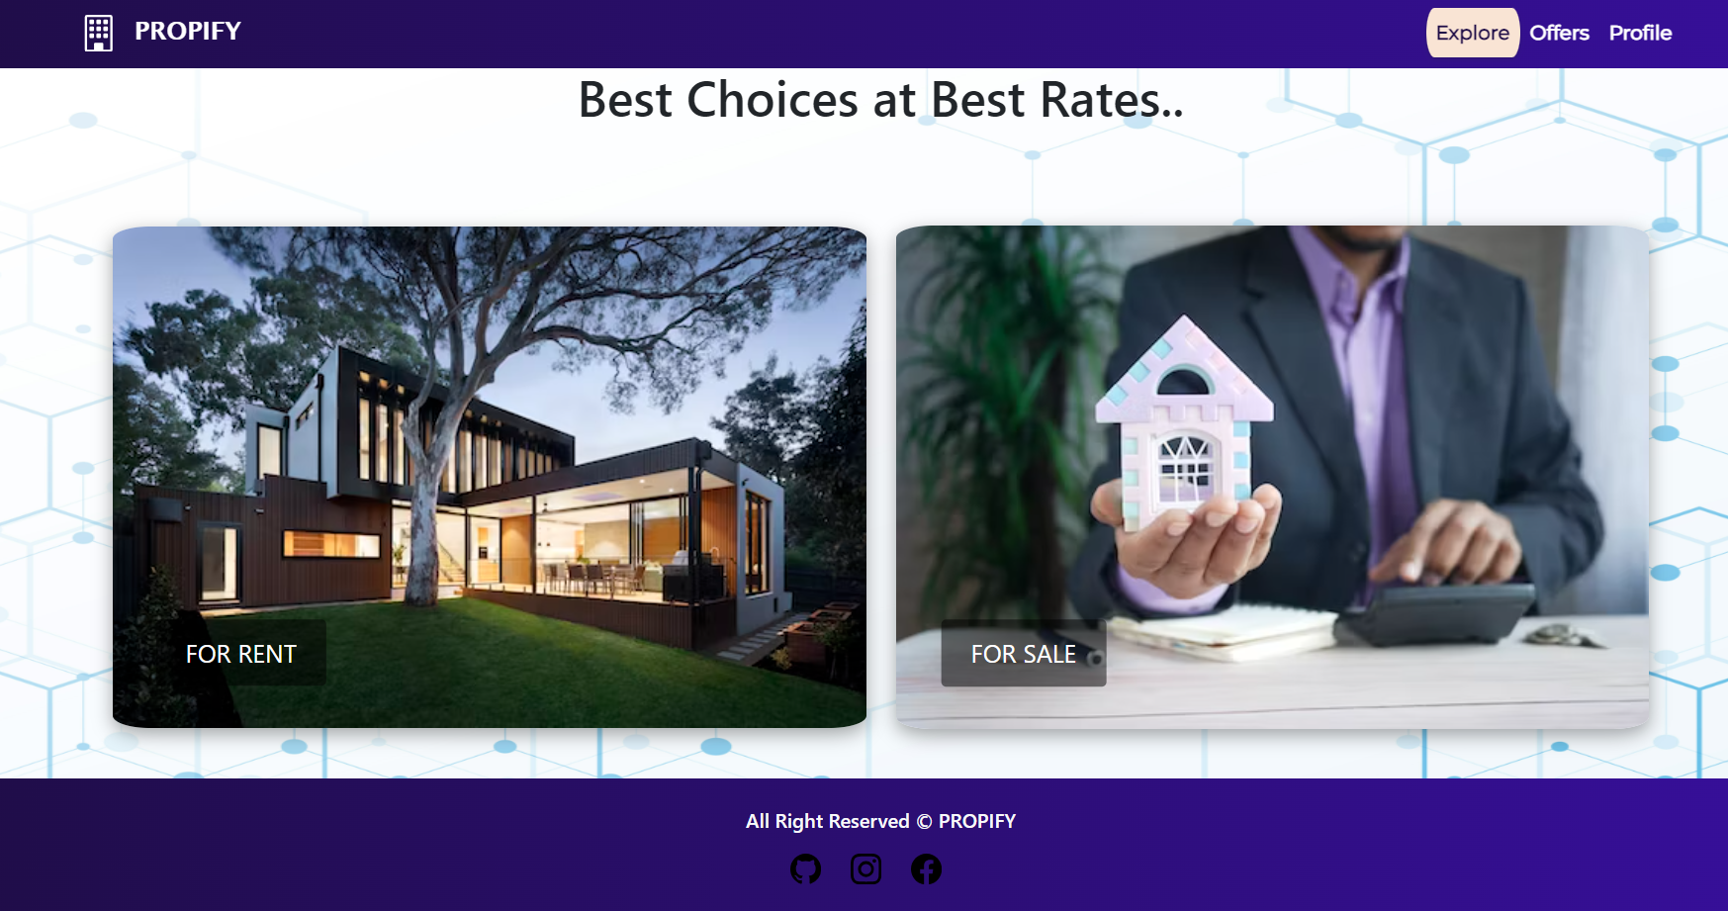
Project Demonstration
Explore Page

Slide 18
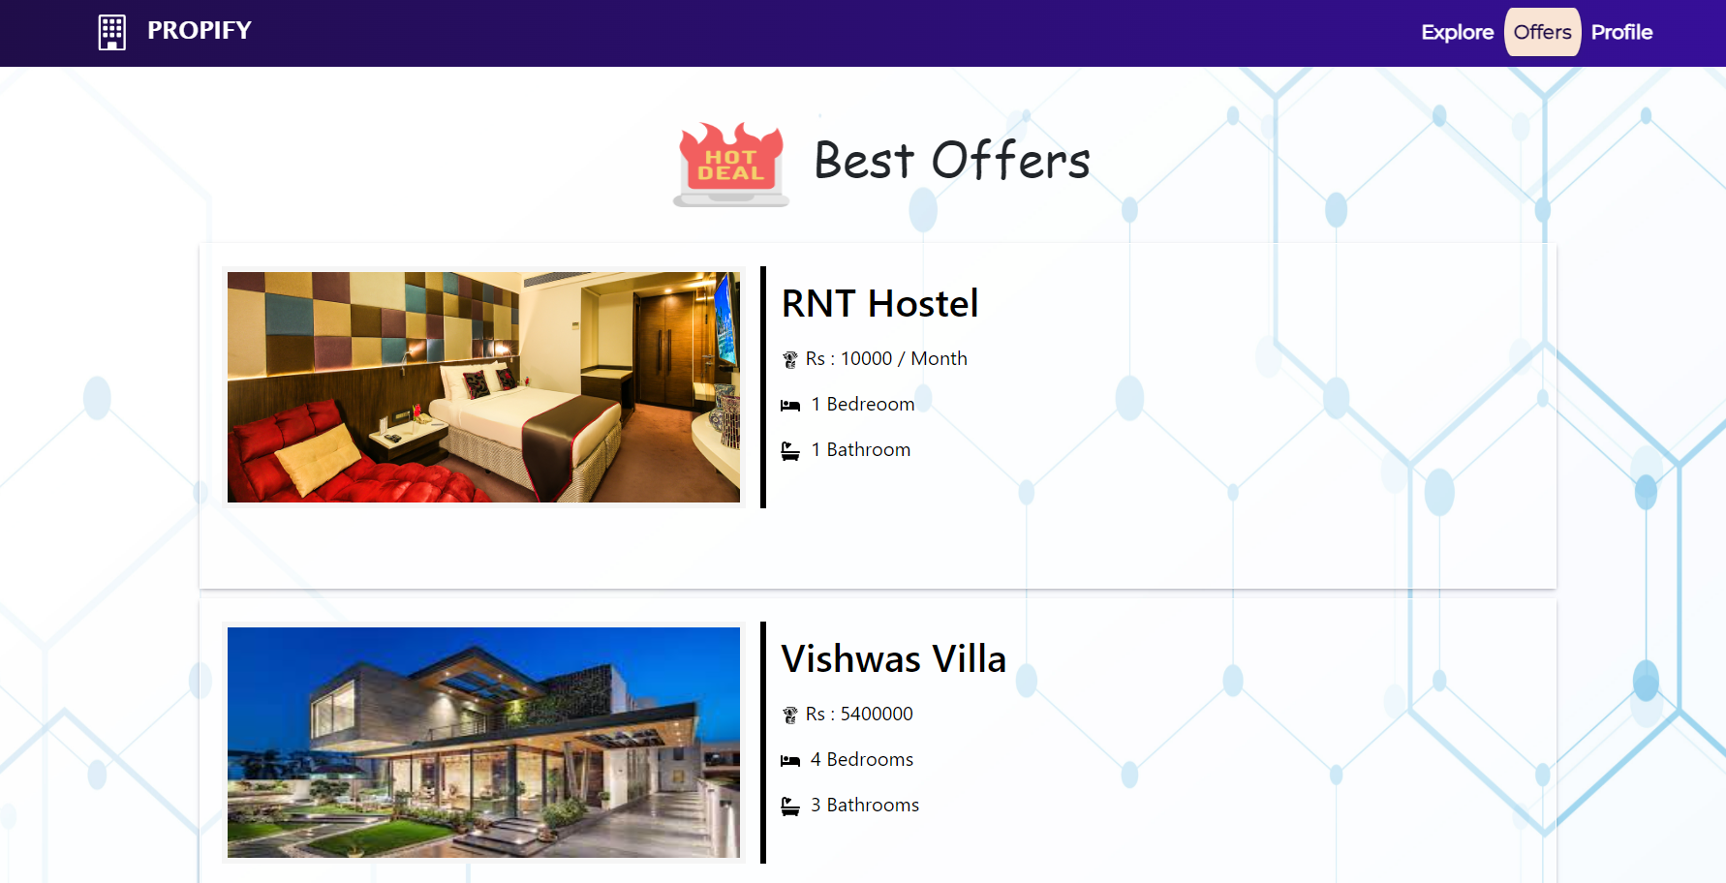
Project Demonstration
Offers and Deals Page

Slide 19
THANK YOU

